Slide 1
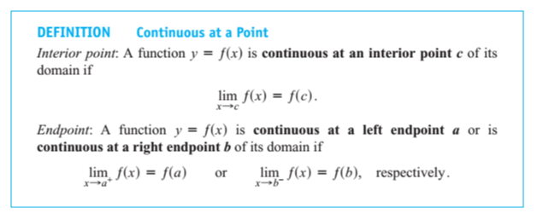
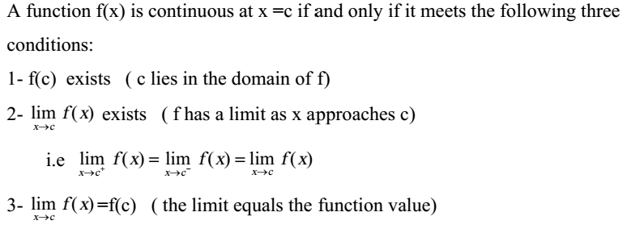
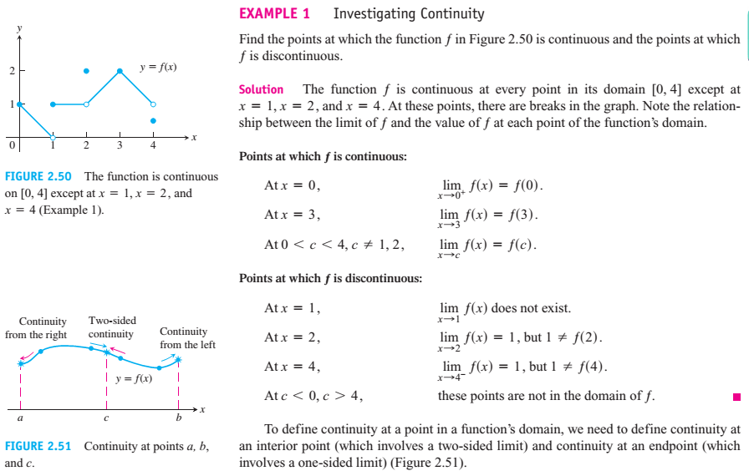
Mathematics Materials Lecturer A.M.Alazzawe FIRST CLASS
SEMESTER ONE
CHAPTER Four
2.6 Continuity
Any function whose graph can be sketched over its domain in one continuous motion without
lifting the pencil is an example of a continuous function.
1

Slide 2
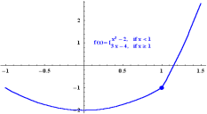
Mathematics Materials Lecturer A.M.Alazzawe FIRST CLASS
SEMESTER ONE
Exercise 1. Find A which makes the function continuous at x=1.
We have
and
So f(x) is continuous at 1 iff
Examples. at x = 3
fails to be continuous at x = 3 since 3 is not in the domain of f.
Examples. at x = 3
at x
=
3
The function does satisfy condition 1 since 3 is in the domain of h, h(3) = 7, and does satisfy condition 2 since
does exist. However, since these two numbers are different, condition 3 is violated and h fails to be continuous at
x = 3.
2

Slide 3
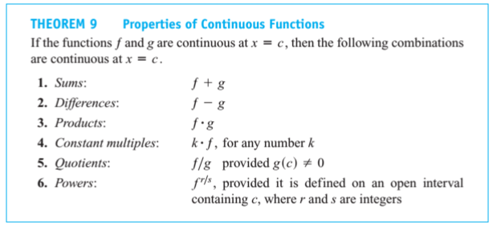
Mathematics Materials Lecturer A.M.Alazzawe FIRST CLASS
SEMESTER ONE
Continuous Functions
3

Slide 4
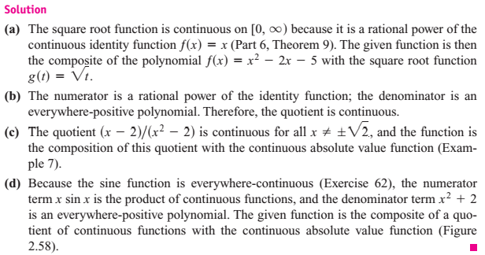
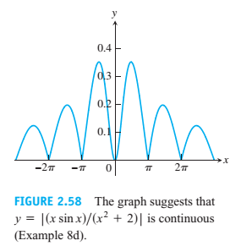
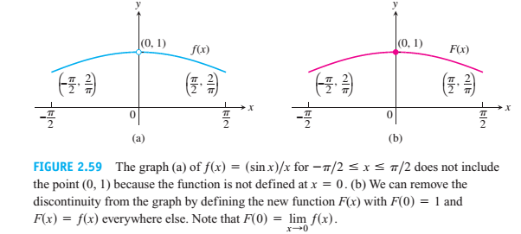
Mathematics Materials Lecturer A.M.Alazzawe FIRST CLASS
SEMESTER ONE
4

Slide 5
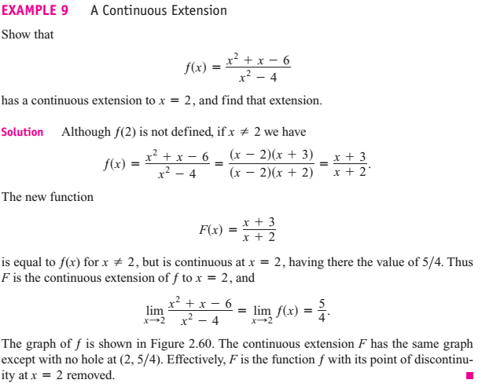
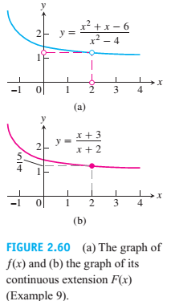
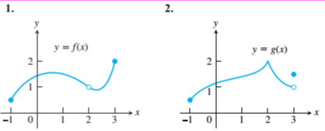
Mathematics Materials Lecturer A.M.Alazzawe FIRST CLASS
SEMESTER ONE
Solved question
In Exercises 1–2, say whether the function graphed is continuous on [-1,3] If not, where does it fail
to be continuous and why?
5

Slide 6
Mathematics Materials Lecturer A.M.Alazzawe FIRST CLASS
SEMESTER ONE
Solution
At what points are the functions in Exercises 13–28 continuous?
Solution
Solution
Find the limits in Exercises, and Are the functions continuous at the point being approached.
Solution
6

Slide 7
Mathematics Materials Lecturer A.M.Alazzawe FIRST CLASS
SEMESTER ONE
Solution
Solution
Solution
7

